Slide 1
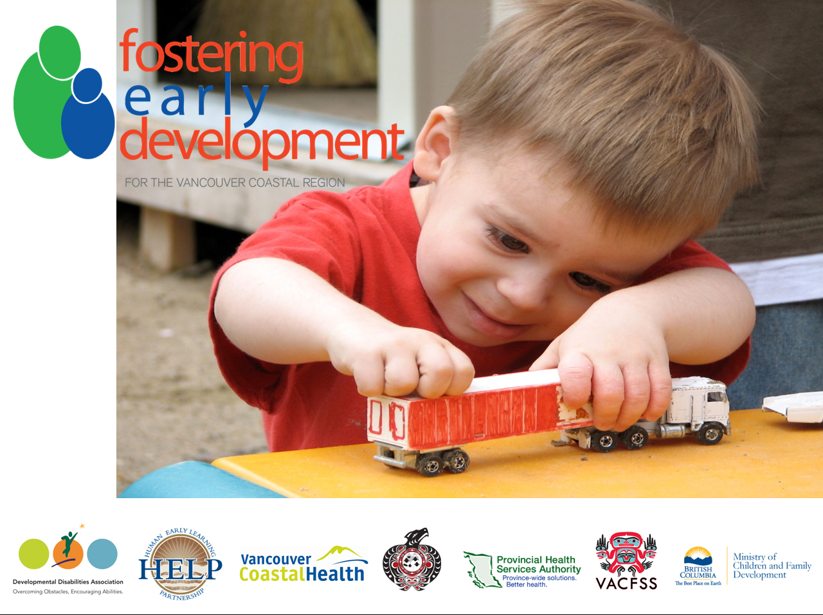

Slide 2

Background
The Joint Special Report- Health and Well-Being of Children in Care in British Columbia: Educational Experience and Outcomes
By The Representative for Children and Youth, Mary Ellen Turpel-Lafond and The Provincial Health Officer,
Dr. Perry Kendall

Slide 3

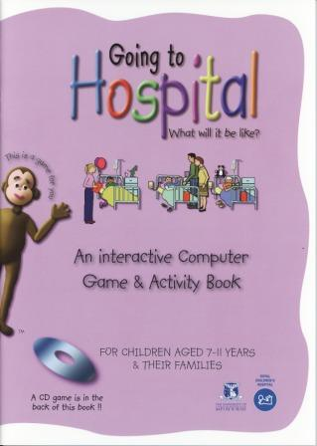
              Stress
Toxic Stress
Strong
Prolonged
Frequent
Changes the architecture of the brain

Slide 4
Stress and the Developing Brain
Neural circuits for dealing with stress are particularly malleable during the fetal and early childhood periods
We assume that infants and young children are the most resilient group, but they are most vulnerable

Slide 5
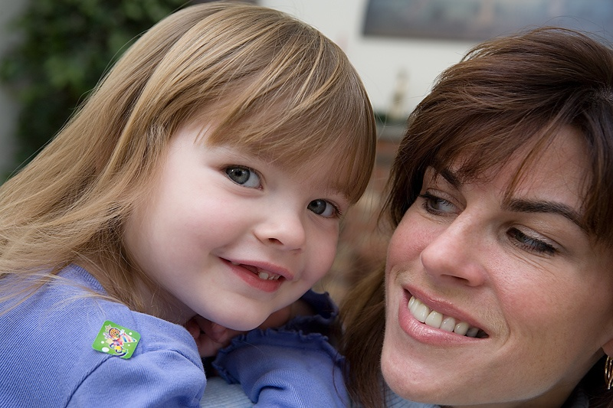
Why Early Intervention?
Has the potential for improving developmental outcomes for children in care
Is likely to be more cost effective than later treatment

Slide 6
Session Outline
Description of Fostering Early Development Program
Training to Foster Parents and Social Workers
Research Findings on the Program
Individual case studies
Foster parents Voices.

Slide 7
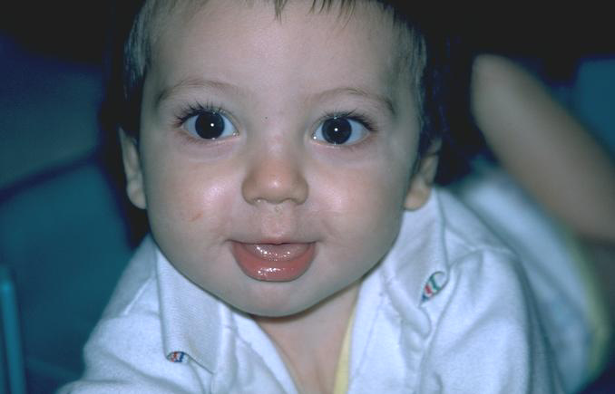
What is the Fostering Early Development Program?
Developmental screening and support
Children in foster care
Birth to six
Vancouver/Richmond and North Shore Coast areas of the Coast Fraser Region
Training for foster parents and social workers

Slide 8
Partnership:
Steering Committee Members
Ayas Men Men Child and Family Services
Aboriginal Infant Development Program
Developmental Disabilities Association
Human Early Learning Partnership
Infant Development Program
Ministry of Children & Family Development
Provincial Health Services Authority
University of British Columbia
Vancouver Coastal Health
Vancouver Aboriginal Child & Family Services Society
Vancouver Native Health Society
Notes:
The program was set up through a collaboration of:-
The Vancouver Coastal MCFD
Vancouver Coastal Health Authority
The Developmental Disabilities Association
Vancouver Native Health Society
Vancouver Aboriginal Child and Family Social Services Society
Ayas Men Men

Slide 9

Staffing
Full time developmental screening coordinator Lesley Rappard
Part time training coordinator Tanya Eichler
Part time developmental screener Amelia Kyewich
Part time secretary Georgette Monem

Slide 10
Objectives
To increase the number of ASQ-3 and ASQ-SE developmental screenings of vulnerable children through a supportive relationship with caregivers
Increase referrals and linkages to appropriate early intervention services
Enhance health monitoring (vision, hearing, dental, immunizations and primary health care provider)
Increase knowledge and skills regarding development for MCFD/VACFSS and Ayas Men Men caregivers and staff
Notes:
The ASQ was selected because it is one of the most widely used developmental screening tools in BC. It has good psychometric properties; sensitivity and specificity rates have been shown to be 86.1% and 85.6%. Also it is easy to complete and score.

Slide 11
How Does This Happen?
Children are automatically referred from the three agencies we serve, MCFD, Vancouver Aboriginal Child and Family Services and Ayas-Men-Men.
With consent, information is gathered on the services the child has received and is currently receiving
The foster parent is contacted and a visit is arranged
Screening is done in home along with the foster parent

Slide 12
How Does This Happen?
Report on each screening is sent to involved professionals
Recommendations and referrals are made to other services
Support is given to the foster parent
Follow up and monitoring is dependent on the age of the child and their performance

Slide 13
Data
Data collection is an important part of the program
We are collecting 104 pieces of data on every child
Every intervention service received and referred to, number of moves in care as well as their performance on developmental screenings while in the program

Slide 14

Figures to date
2009-2013
  296 children have been screened by FED
  432 referrals further assessment and intervention
  219 children are currently registered

Slide 15
Screening Tool
Notes:
If a child is functioning below the cutoff i.e. in the black zone they are referred to intervention services.
If they are functioning in the grey area or monitoring zone then they are monitored frequently depending on their age. Every 2mths to 1yr, every 3mths to 3yrs and every 6mths to 6yrs.
If they are functioning above the cutoff they are still monitored at recommended intervals. This is every 4mths till they are 2 and then every 6mths until they are 5yrs.

Slide 16
Profile of Children Screened
Of the 296 children screened on the ASQ-3
27% are not meeting their milestones
26% are in the grey zone and are being monitoring
47% are developmentally on track
On the ASQ-SE 34% have scores indicating difficulties in social-emotional functioning.
Notes:
We also administer the Ages and Stages Social-emotional screening tool which gives a measure of social-emotional development.

Slide 17
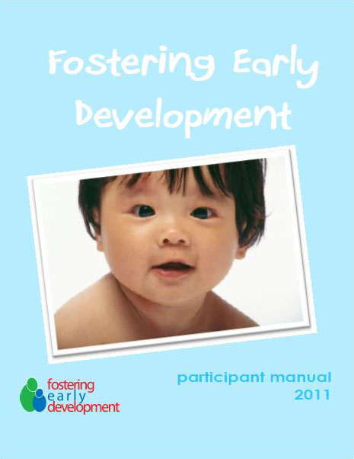
Training
Training for foster parents and social workers is a cornerstone of this program
Development of a trainer manual
Development of a participant manual

Slide 18
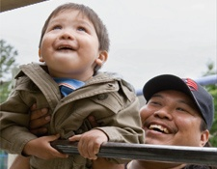
2 Day Training
the ASQ-3 and ASQ-SE
brain development and the impact of trauma
strategies to enhance development within the home
information on community resources and referrals
Notes:
To date we have trained:-
176 foster parents
117 social workers

Slide 19
Additional Training Benefits
Positive interaction between foster parents to improve community support
Shared strategies to enhance development in the home
“Brainstorming” around community supports available and referral instructions
To date:
176 Foster parents trained
117 Social workers trained

Slide 20

WHO
Training Feedback
Most Valuable things I learned were:
“The effects of trauma on the brain & its far reaching effect on the future of the child when not corrected, but that it is a bright & hopeful future we & resources can provide as a team”
“chronological development-physical, Social-emotional and impact of interaction w/ child”
“the amount of resources that are
available”
“that I need to learn more”

Slide 21

Training and Support
Along with the Safe Babies Program
run a training and support group for foster parents
Publish a Newsletter for foster parents and social workers

Slide 22
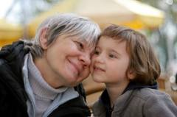
Anne: A Training Success Story
Foster parent Lori received training in the fall of 2012
In the New Year she received 5 siblings in her home
Anne (second youngest at 3 years of age) stood out
as struggling the most with behavioural issues
Lori completed an ASQ-3 and ASQ-SE with Anne from her training manual and
created her own
recommendations with the
results

Slide 23
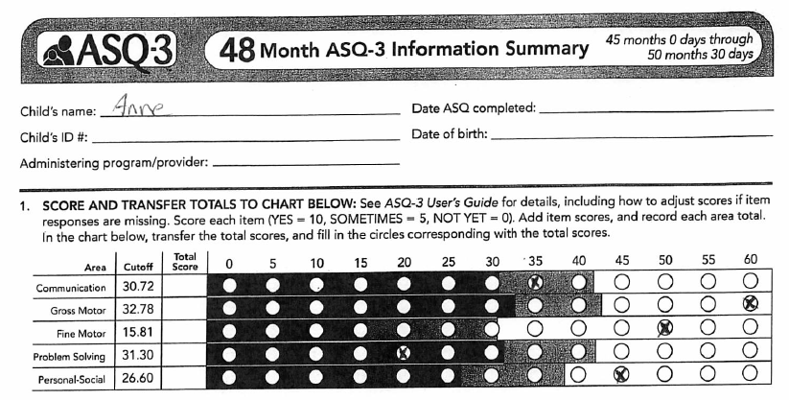
My ASQ results from Daycare

Slide 24
Follow-up
Speech Therapy at the Daycare Centre
Art Therapy
Family Therapist in the Foster Home
Referral to Sunnyhill Hospital CDBC clinic
Behaviours have reduced at home and in daycare quite dramatically
Social worker has discussed prenatal exposure with birth mom (confirmed)
Transition to elementary school should be more appropriately supported due to greater understanding of behaviours

Slide 25
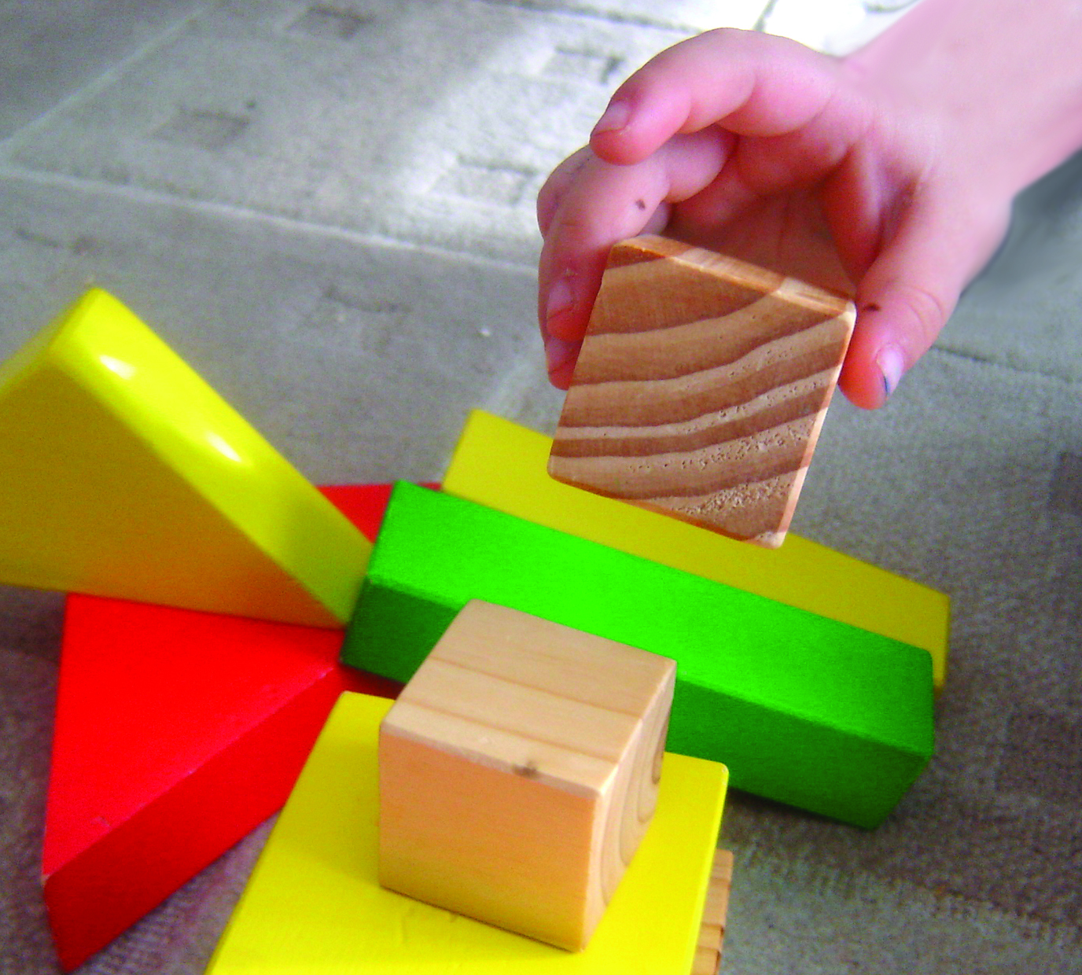
Research results on Fostering Early Development
  In collaboration with UBC and HELP
  Focus to establish baseline information to direct future planning.
Notes:
UBC through the Human Early Learning Program have done research on the program.
The main focus was to establish a baseline to direct future planning but they also wanted to establish the usefulness of having a program such as FED.
Dr. Susan Dahinten and her research assistant Samar Hejazi conducted the research.

Slide 26
Methods
  Impact of FED was assessed by focusing on children who had been in care for more than one year prior to admission to FED
  The outcomes of interest were:
  The unmet health screening and immunization needs identified by FED
  The developmental concerns identified by FED
Notes:
In order to assess the impact of FED they focused on a group of children who had been in care for more than one year. The idea was to establish, if these children had been in care for more than one year, had all their health and development needs been identified.
If they had not been identified, then any needs uncovered by FED in this group, could be argued as the benefit of the FED program.
We had to take this approach because no control group was available

Slide 27
Findings: Developmental Concerns
Among FED Children who had been ‘In Care’ > 1 Year
The impact made by FED = earlier identification
Notes:
27

Slide 28
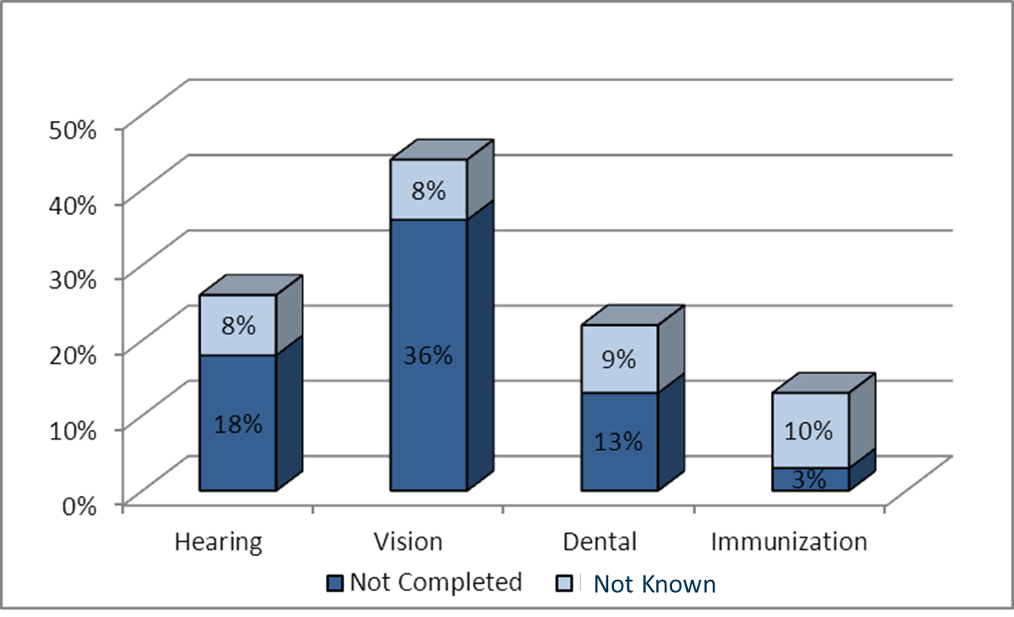
Unmet Needs for Health Screening & Immunization Among children who had been ‘In Care’ > 1 Year(N=190)
Notes:
The findings clearly indicate a need for a more systematic approach for monitoring and supporting health screening and immunizations for children in care.

Slide 29
Research Conclusions
FED program offers significant services compared with prior, routine care
High rates of developmental concerns for children that had been in care over a year
Importance of formalised, systematic screening and monitoring procedures of health and developmental needs of children in care

Slide 30

Child vs Child
Child A = John
Child B = Frank
Similarities
- Age
- Prenatal history
- Family Caregivers
- Referral to FED

Slide 31
John and Frank
ASQ-3 is a tool to assess infants and children for possible delays in development. A low score indicates difficulties.
John | Norm | 54 months | 60 months
Communication | 60 | 60 | 50
Gross Motor | 60 | 50 | 35
Fine Motor | 60 | 35 | 45
Problem Solving | 60 | 45 | 60
Personal-social | 60 | 30 | 60
Frank | Norm | 54 months | 60 months
Communication | 60 | 60 | 45
Gross Motor | 60 | 50 | 55
Fine Motor | 60 | 35 | 45
Problem Solving | 60 | 45 | 20
Personal-social | 60 | 30 | 60

Slide 32
John and Frank
The ASQ-SE is a tool that measures social –emotional skills including self-regulation, compliance, communication, adaptive functioning, autonomy, affect, and interaction with people. A high score indicates difficulties.
John
Age | Norm | Score
48 months | 70 | 80
60 month (Sept 2012) | 70 | 150
60 month (Mar 2013) | 70 | 210
Frank
Age | Norm | Score
48 months | 70 | 15
60 month (Mar 2012) | 70 | 25
60 month (Sept 2012) | 70 | 0

Slide 33

Joshua
Joshua was first seen at 24 mths. He had lived with his foster parent since 1yrs old. At this point he had not had any intervention services.

Slide 34
Joshua

Slide 35
Joshua

Slide 36
Joshua

Slide 37
Joshua

Slide 38
Joshua

Slide 39
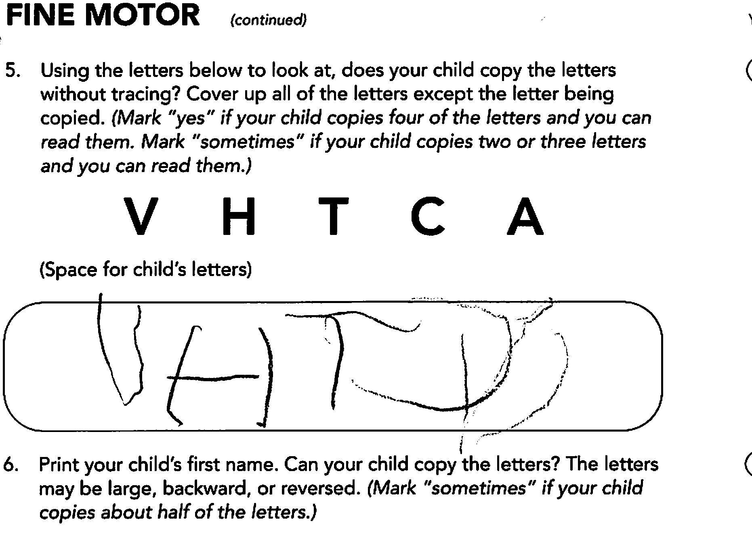
Joshua

Slide 40
Joshua

Slide 41
Joshua
Helped diagnose an attention difficulty
Enable foster parents, preschool teachers and teachers to be proactive and how to interact
Smooth passage into preschool and then Kindergarten
Swimming
Successful start in school, intact self esteem, maximise his potential for making friends

Slide 42
Thank You

