Slide 1
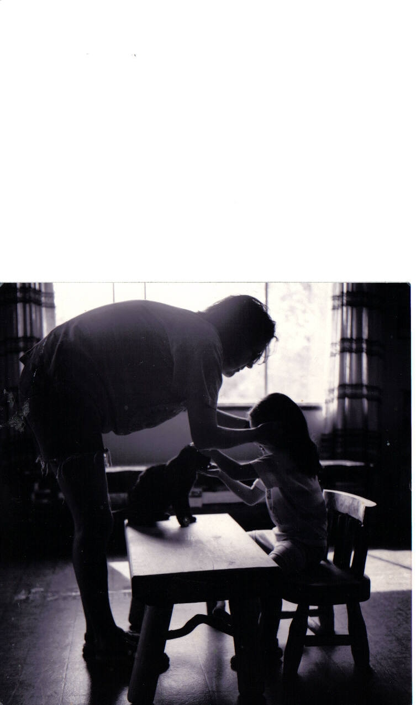

Slide 2
Time Immemorial to Time Immortal: Relationships with Professionals as Extended Family
Michele A Sam
Ktunaxa Nation
Human Early Learning Partnership-
Senior Aboriginal Researcher

Slide 4
Ideological and Spatial Diaspora
Cree Scholar Neal McLeod describes the processes of exile as not only land based, but also how over generations our limited relationship to our lands perpetuates our limited relationship to our ways of knowing, doing and being.
He also suggests that “coming home” is possible by re-energizing indigenous values.
Is “Education is our new Buffalo” ?

Slide 5
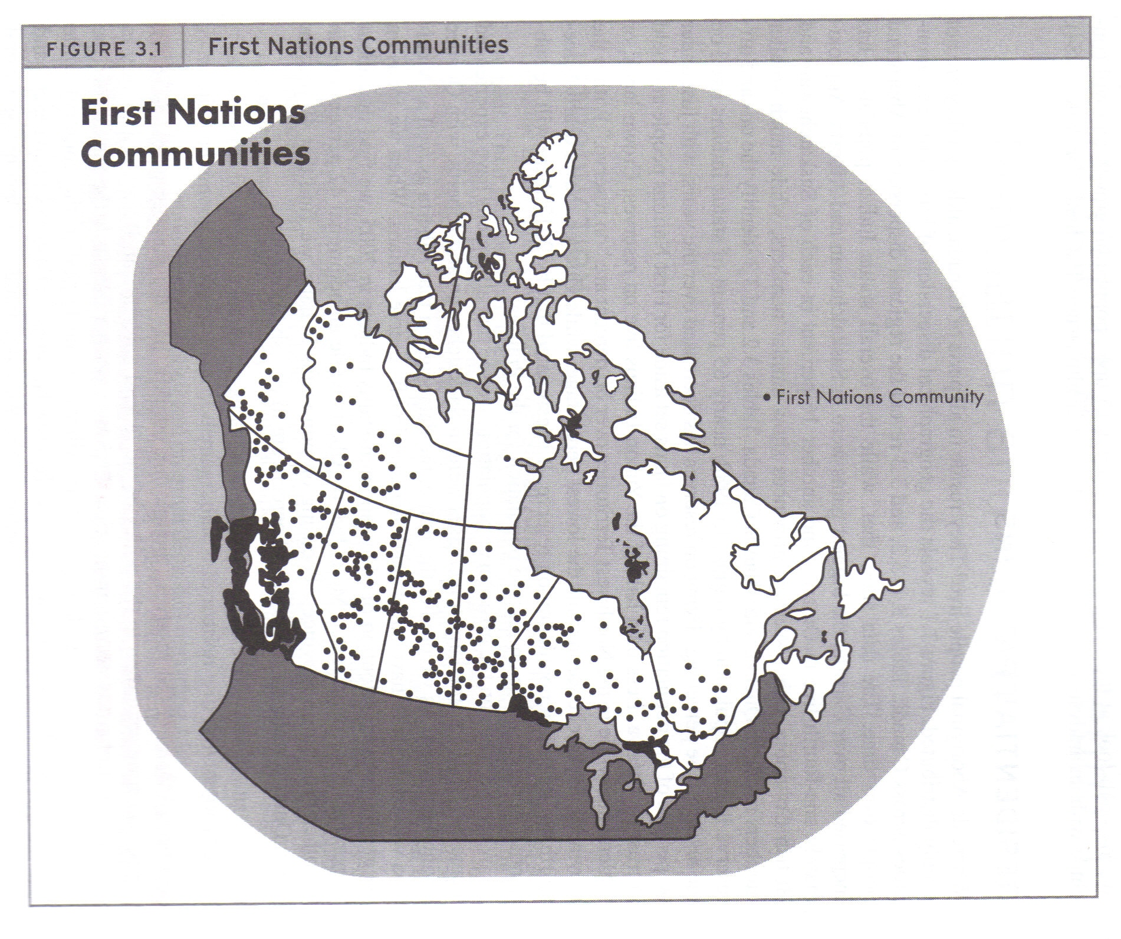
Notes:
A result of dysconsciousness and dysconscious racism, this is how indigenous peoples are thought be organized without question. The concern for the well being of the first peoples is also implemented following this sort of structuring of isolated and silo-ed programs and ways of being. It is a time of disconnection

Slide 6
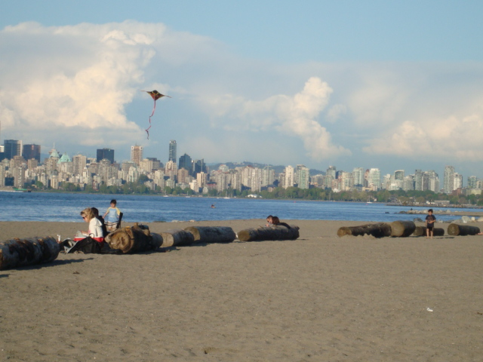
Dysconsciousness
involves a subjective identification with an ideological
viewpoint that admits no fundamentally alternative vision of society
(in King, J.E., 1991 pg 135).

Slide 7
Seven processes of Colonization
Geographical incursion of colonizing group
Socio-cultural destruction
External Political Control
Economic dependence/economic development
Provision of low quality social services
Racism
Colour Line
Notes:
7
Frideres and Gadacz (2008). Aboriginal Peoples in Canada, 8th ed.
Chapter 1: The Legacy of Canadian Colonialism
Pgs. 1-5
Indian people do not have a monopoly on colonization. It is a process used on ‘their own’ people in Europe. The difference is that we are indian people, because we were so very conscious and strong minded and hearted, we are well aware of what is happening to us and our children.
These are the processes affecting our selves, our lands, our beliefs and our relationships to each other.

Slide 8
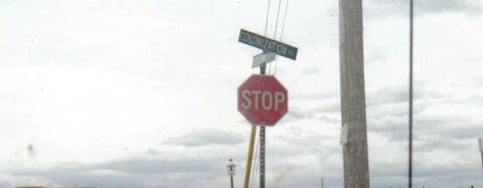
Four basic principles underlie Federal Indian Policy implemented in British Columbia.
They are:
-Indians are Inferior.
-There are inherent land use, land misuse and land abuse issues by Indian people.
-Indian ways of living are detrimental to ourselves.
-Indian extinction is inevitable.

Slide 9
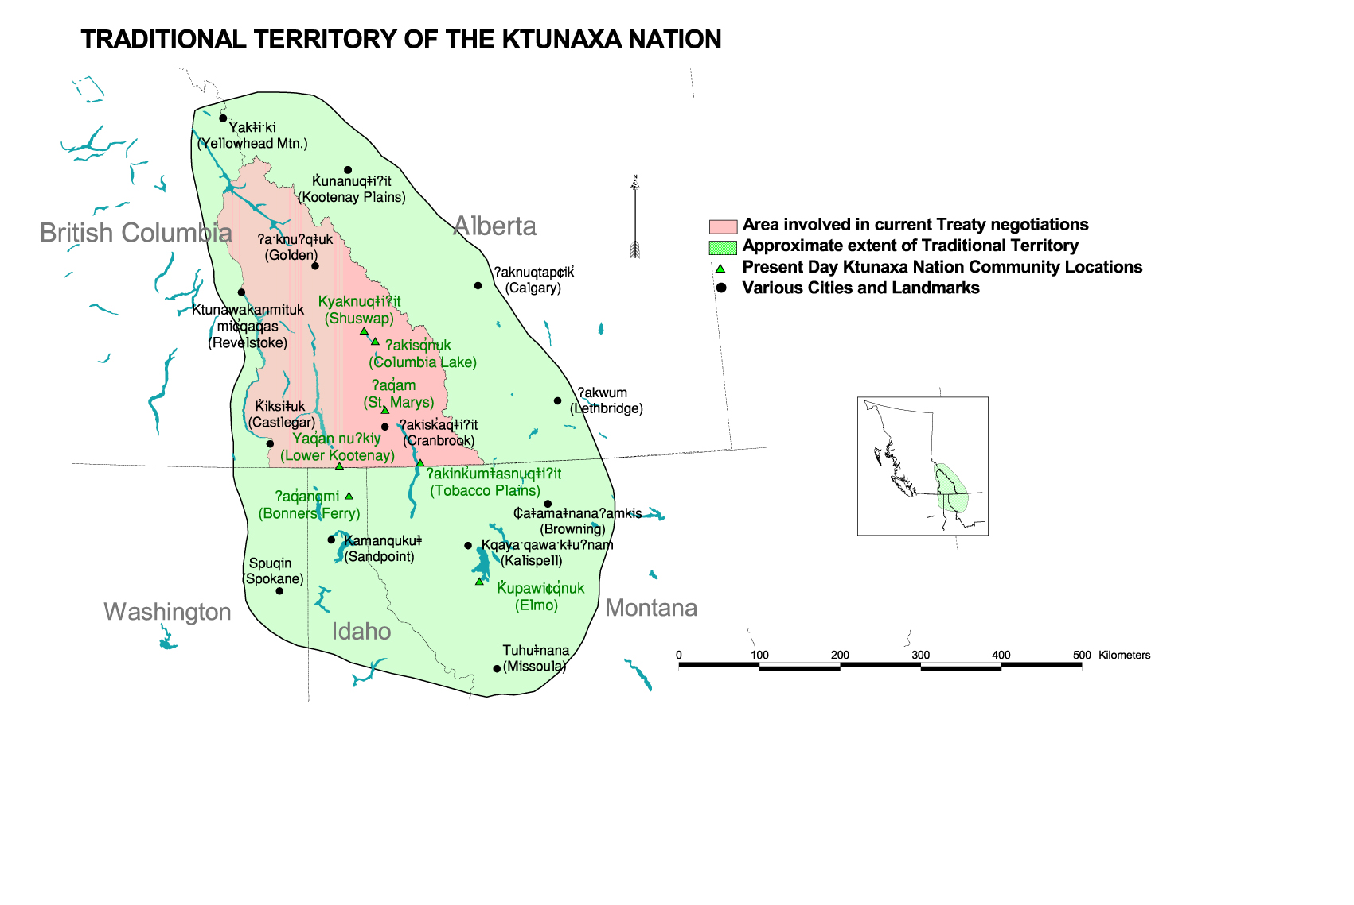
Notes:
This map shows the various organizations of my own nation

Slide 10
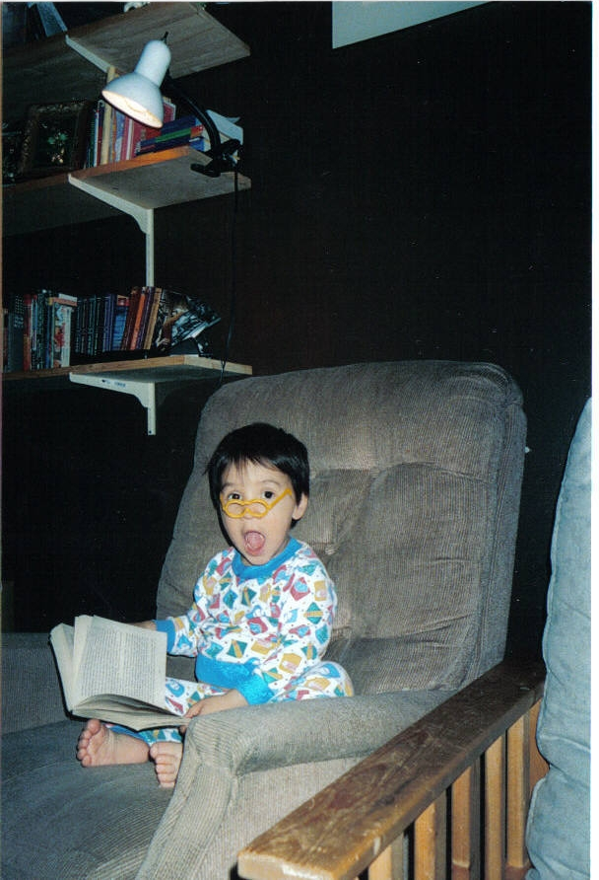
Dysconscious Racism
a form of racism that tacitly accepts dominant White norms and privileges. It is not the absences of consciousness (that is, not unconsciousness) but an impaired consciousness or distorted way of thinking about race (King, J.E., 1991).

Slide 11

If you wanted a recipe for the destruction of personality, one such
would be this:
destroy the material basis of a culture;
force the people into an environment
which provides little means for economic activity;
foster the culture of poverty and
dependency by means of
minimal handouts;
make ignorant and racist attacks
on the structure and superstructure
of what remains of the culture;
as the adults disintegrate from
these shocks, experiment blindly
with their children.

Slide 12
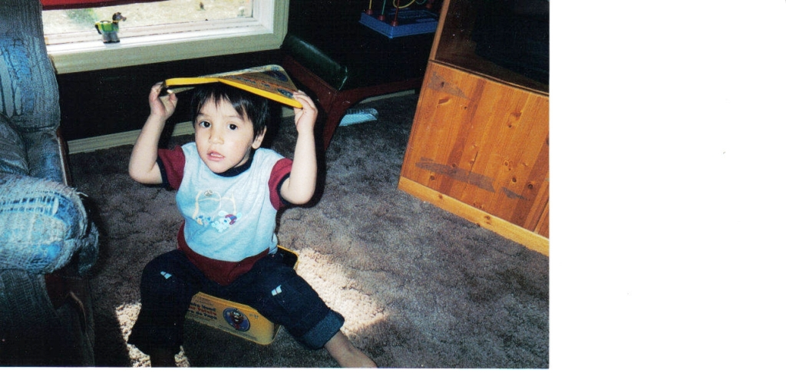

Slide 13

Reviving Our Ancestors Dreams: Becoming Conscious for Our Descendents

Slide 14
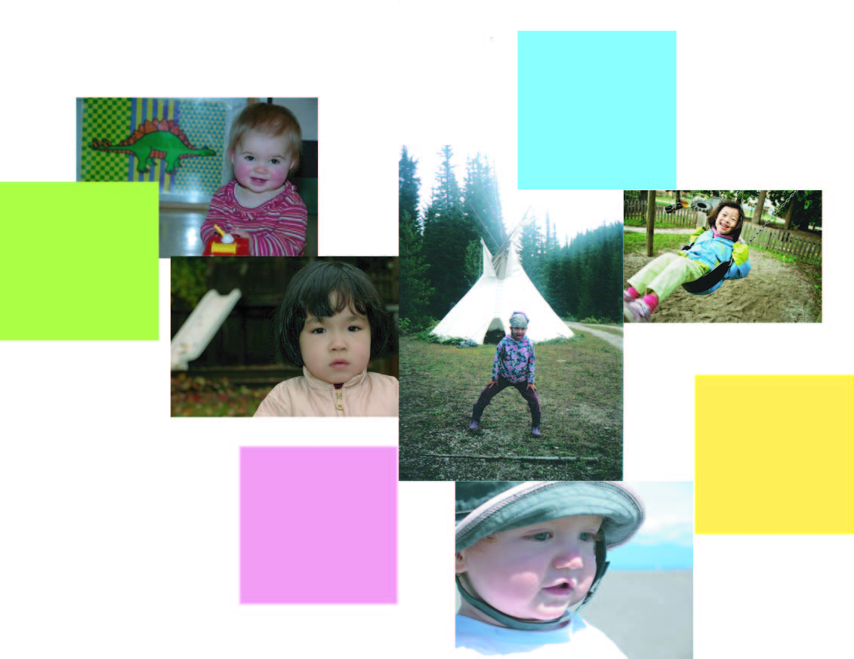
Human Early Learning Partnership

Slide 15
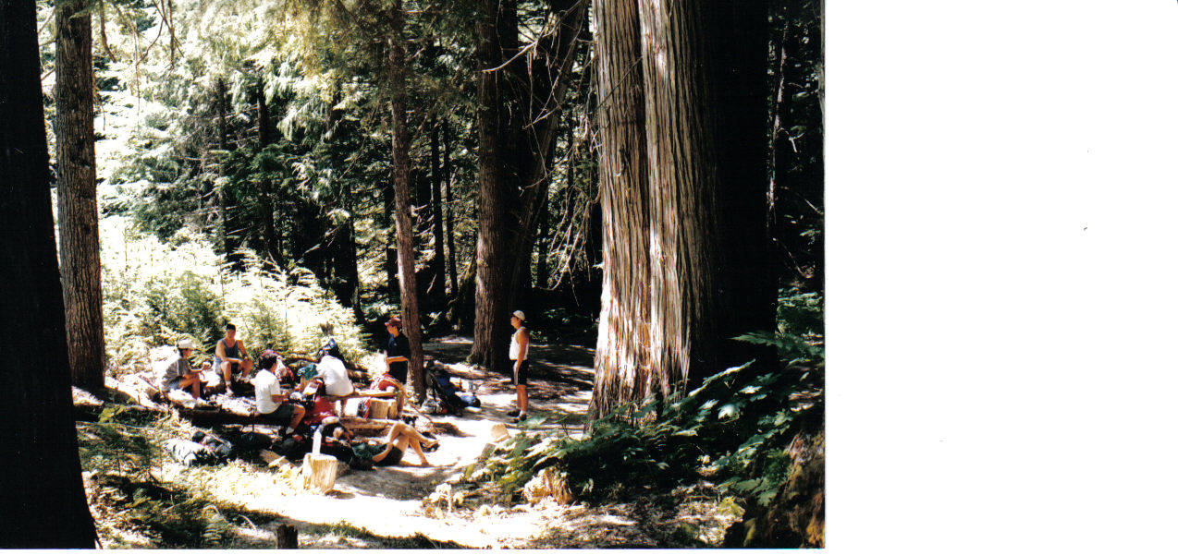

Slide 16
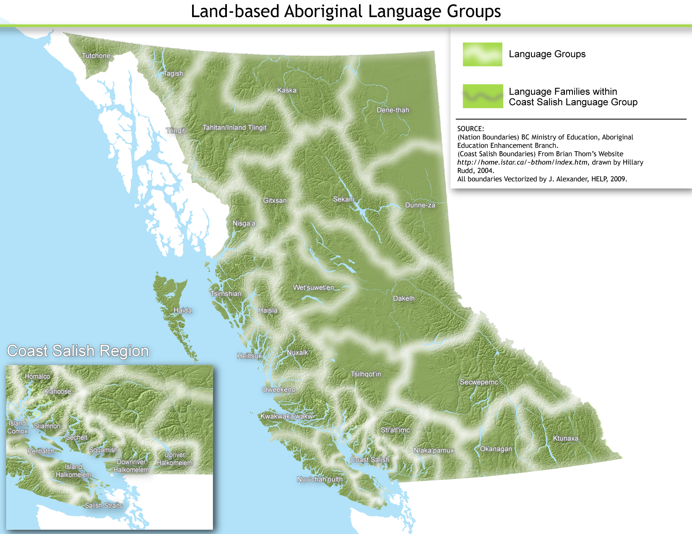

Slide 17

In order to meet our children’s needs,
We must neglect our children’s needs.
I am the first generation, with legal uncontested custody of my children, in over 4 generations

Slide 25
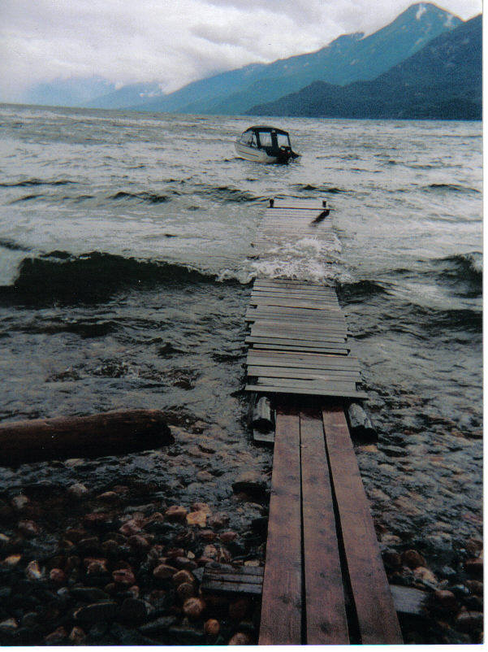
Creating a new memory
in the minds of our children…

